Slide 1



Play to Learn: Tic-Tac-Toe Using Deep Q-Network

Slide 2
Introduction
Tic-Tac-Toe is a classic two-player game played on a 3x3 grid, aiming to align three marks in a row. In this project, instead of traditional rule-based logic, we implemented a Deep Q-Network (DQN), a reinforcement learning technique that uses neural networks to approximate Q-values for decision-making. The AI agent trains by playing thousands of games against a random opponent, learning optimal strategies through rewards and penalties. The objective is to build a console-based Tic-Tac-Toe game where users can play against a DQN-powered AI that improves its gameplay over time through continuous learning.

Slide 3
What is DQN?
DQN stands for Deep Q-Network.
Combines Q-Learning with deep neural networks.
Learns optimal policies via interaction with environment.
Used in advanced AI like AlphaGo and Atari games.

Slide 4
Background Study
Tic-Tac-Toe is a well-known strategy game with a finite number of possible moves, making it an ideal testbed for AI learning.
Traditional AI approaches use Minimax algorithms, which exhaustively search all possible game states.
Instead of predefined rules, machine learning (ML) allows AI to learn optimal strategies through experience.
Reinforcement Learning (RL) enables an AI agent to learn by interacting with an environment and receiving rewards for good moves and penalties for bad ones.
Deep Q-Networks (DQN), a deep reinforcement learning method, allow the AI to learn strategies through trial and error.
DQN combines Q-Learning with neural networks to estimate the expected future rewards (Q-values) of actions in different states
Teaching AI to play games like Tic-Tac-Toe provides a foundation for developing more advanced AI systems.
The AI learns by playing many games, receiving positive rewards for good moves and penalties for bad ones, improving over time.

Slide 5
Motivation
Offers hands-on experience with Deep Q-Networks (DQN), combining neural networks with reinforcement learning.
Demonstrates how an AI agent can learn optimal strategies through self-play and reward feedback, not hardcoded rules.
Unlike traditional Q-learning, DQN handles larger state-action spaces efficiently using deep learning.
Reinforces understanding of exploration (ε-greedy), experience replay, and target networks—core DQN concepts.
DQN is widely used in advanced AI applications such as playing Atari games, robotics, and real-time decision-making.
Observing how an AI improves through episodes and learns to win more often is highly motivating.
Bridges the gap between academic ML knowledge and real-world AI problem-solving.

Slide 6
Why Choose DQN over Q-Learning?
Scalability to Complex Problems
Learning from Raw Input
Improved Stability and Convergence
Generalization Across States
Enhanced Exploration with Epsilon Decay
Efficient Learning with Deep Networks

Slide 7
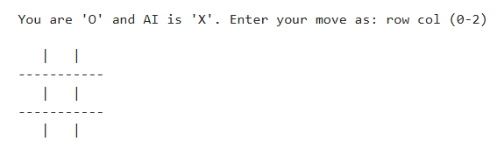
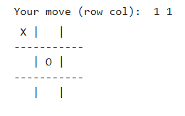
Results
Figure 1: Playing Scenario 1
Figure 2: Playing Scenario 2

Slide 8
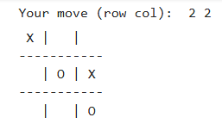
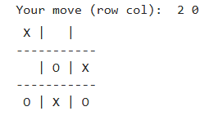
Results
Figure 3: Playing Scenario 3
Figure 4: Playing Scenario 4

Slide 9
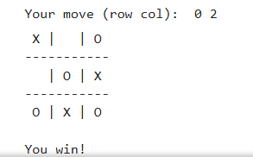
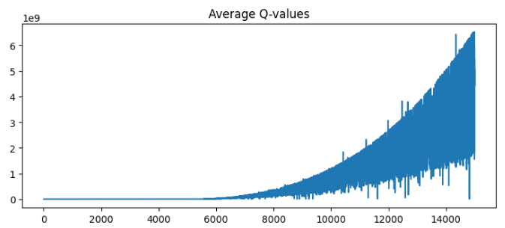
Results
Figure 5: Playing Scenario 5
Figure 6: Average Q-values per Episode during DQN Training

Slide 10
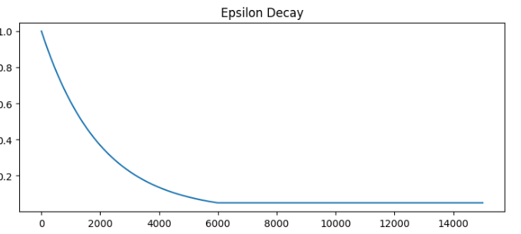
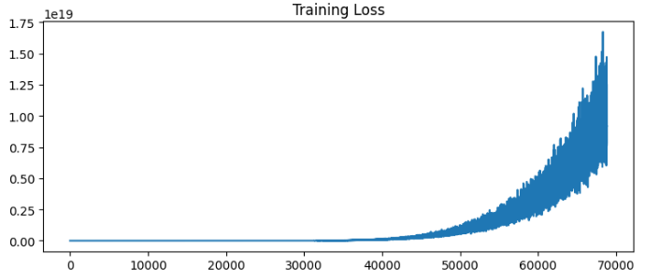
Results
Figure 7: Epsilon Decay over Episodes
Figure 8: Training Loss Progression of Deep Q-Network (DQN)

Slide 11
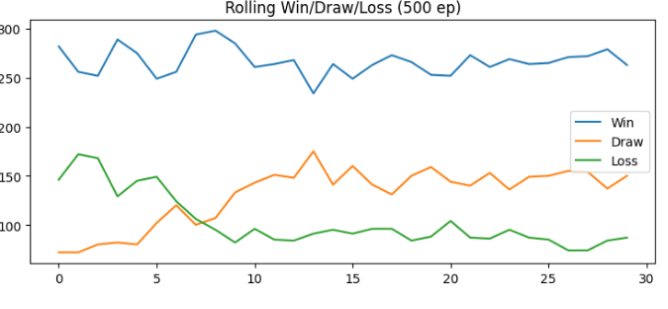
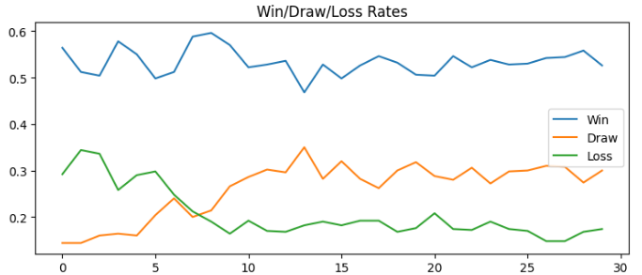
Results
Figure 9: Rolling Performance over Episodes
Figure 10: Win, Draw, and Loss Rates of DQN Agent Over Episodes

Slide 12
Future Improvement
Adaptive Difficulty Using DQN Parameters: Adjust exploration rate and reward functions based on user performance.
Graphical User Interface (GUI): Develop using Tkinter or Pygame for interactive gameplay.
Enhanced Deep Q-Network (DQN) Architecture: Experiment with deeper networks, target networks, or Double DQN.
Real-Time AI Performance Visualization: Show metrics like win/loss/draw counts, epsilon decay, and Q-value trends.
DQN Multiplayer Integration: Enable human vs. human and human vs. DQN gameplay, with online/LAN support.
Heatmap and Q-Value Visualizations: Visualize the agent's decision-making using Q-value heatmaps for each board state.

Slide 13
Conclusion
The DQN-Tac-Toe project successfully applies Deep Q-Networks (DQN) to create an AI agent for Tic-Tac-Toe, enabling human players to engage with the agent in a game setting. While the current version is console-based, it serves as a foundational implementation for reinforcement learning with deep learning techniques. Future improvements, including a graphical user interface (GUI), enhanced DQN architecture, real-time learning metrics visualization, and multiplayer support, will significantly enhance both functionality and user experience, making the game more interactive, stable, and adaptive to player performance.

Slide 14
Thank You

